Slide 1

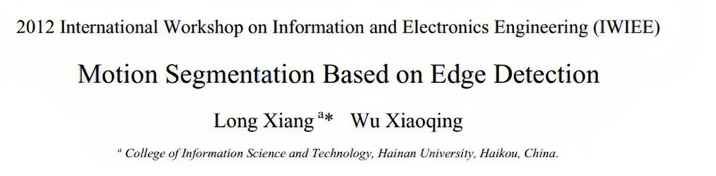
Presenter: Muntasir Ahmed Ador
ID: 20101259
Course:CSE424
ID:20101259
Course: CSE424(Pattern Recognition)

Slide 2
Presentation Structure
1.The Generalized idea of motion segmentation based on edge detection.
2.Introduction.
3.The problem of motion segmentation.
4. Background edge removal.
5.Experimental results.
Conclusion.

Slide 3
The Generalized idea of motion segmentation based on edge detection
Motion segmentation based on edge detection is a technique used in computer vision to identify moving objects in videos or image sequences. In simpler terms, it helps a computer recognize and separate objects that are in motion from the background.
Here's how it works in everyday language:
Detecting Edges: First, the computer looks for the edges of objects in the video or image. It does this by finding the places where the object's outline meets the background.
Tracking Motion: The computer then observes how these edges change over time. If an edge moves, it suggests there's something in the image that's moving.
Separating Moving Objects: Once the computer identifies these moving edges, it tries to separate them from the stationary background. This way, you get a clear picture of what's moving and what's not.
The goal is to do this accurately and efficiently. It's important in various applications, like surveillance, tracking objects in videos, or even in self-driving cars to understand what's happening around them. However, it can be challenging, especially when some parts of the moving object are hidden or "occluded" by other objects. This paper proposes a new method to do this effectively while minimizing the computational work required.

Slide 4
Introduction
The text discusses the significance of model-based motion segmentation in computer vision. Various methods are highlighted, including the use of statistical theory to estimate model parameters and motion regions. Notable techniques mentioned include Markov random fields and multiscale Gibbs models, Kalman filters, Probabilistic Data Association Filters, the level set method, and a MAP (Maximum A Posteriori) method.
One common challenge in these methods is occlusion, where moving objects can hide parts of the background, making segmentation less accurate. The paper introduces a new model-based segmentation approach designed to accurately capture the edges of moving objects with reduced computational complexity. The paper's structure includes a brief introduction to their motion segmentation method in section 2, a detailed description of a background edge removal method based on pattern recognition in section 3, and the presentation of experimental results in section 4.

Slide 5
The problem of motion segmentation
This paper addresses the challenge of motion segmentation, which is essentially a problem of pattern recognition. The objective is to classify edge pixels in a sequence of images into two categories: object or background, without considering occlusion. To achieve this, the Canny edge detection method is used to identify edges in the images.
After applying the Canny operator, an edge mask image is generated, serving as the data source for the pattern recognition process. The paper makes an assumption that the background either moves as a rigid body or remains stationary. Based on this assumption, the edges in the mask image are categorized into two types: background or object. If the pixels on both sides of an edge move in the same way, it is classified as part of the background. Conversely, if the pixels on either side of the edge move differently, it is considered part of the moving object.
In this manner, the paper employs pattern recognition to distinguish between different pixel movements. Once all edges in the mask image are classified, the edges belonging to the object are retained, while those belonging to the background are removed. This process helps identify and separate moving objects from the stationary or globally moving background.

Slide 6
Background edge removal.
In our algorithm, the Canny edge detection algorithm runs in 5 separated steps: (1) Smoothing; (2) Finding gradients and orientations; (3) Non-maximum suppression; (4) Double threshold; (5) Edge tracking.
It is done in 4 parts:
1 Motion segmentation model.
2. Motion parameters estimation.
3. Background edges removal based on pattern recognition
4. Analysis of the threshold DK.

Slide 7

Motion segmentation model
In order to make it suitable for parameterization, model-based segmentation method is usually established with optical-flow equation. Generally, parameterized motion segmentation model can be used for a compact representation of the motion field [6]. In this paper, we employ a six-parameter affine motion model. The affine motion segmentation model comes from the 2-D motion field on the image. It has the following form
: where a1... a6 denote the affine-motion parameters of the pixel (x, y) in the image. ( ) v A,b ( ) x, y denotes the velocity as predicted in the model.

Slide 8

Motion parameters estimation
Define C1 as the area at one side of an edge, and C2 as the area at the other side. Pixels in C1 are moving the same way, so do pixels in C2. We can denote the affine parameter vector as following:
where i denotes the one side of an edge. If every pixel in an area Ci has the same behave, there should be the following function:

Slide 9

Background edges removal based on pattern recognition
Here we assumed that there always were some small areas aside of an edge. All pixels in one of these areas are moving the same way. So if pixels belonging to the areas locating at the two side of the edge are moving the same way, that is to say, pixels at the different side of edge have the same behave, this edge should belong to the background, and should be removed. If pixels belonging to the areas locating at the two side of the edge are moving the different way, that is to say, pixels at the different side of edge have the different behave, this edge should belong to the object, and should be remained. In the pattern recognition process, we choose the motion vector Ai, i=1, 2 as the feature of pattern recognition, and define the distance measure D(x, y) between two affine motion parameter vectors A1 and A2 is given by:
where M is a 6×6 scaling matrix. (x, y)is the location of a pixel on one of edges,A1 is the motion parameter vector of a small area on one side of the pixel (x, y), A2 is the motion parameter vector of a small area on the other side of the pixel (x, y).

Slide 10
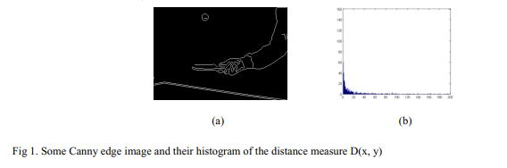
Analysis of the threshold DK.
The paper discusses the use of histograms to analyze a distance measure called D(x, y). Fig 1 presents histograms of D(x, y) for images selected from specific sequences, with a scaling matrix M set to the identity matrix. The paper finds that the distribution of D(x, y) has two parts in its histogram. The part near the origin contains smaller D values, likely representing background, while the other part is more uniformly distributed, suggesting it belongs to the moving object.
To classify these edge pixels, the paper introduces a classification point DK, determined from the histogram. Pixels with D values less than DK are categorized as background, while those with D values greater than DK are considered part of the moving object. The inflection point on the histogram curve is chosen as the classification point, with most edge pixels on one side representing the background and the others indicating the moving object.
The process for removing background edges involves estimating areas around edge pixels, calculating the distance D(x, y), and applying the classification criteria using DK. If the distance D(x, y) is greater than DK, the edge pixel is retained; otherwise, it is removed. This process effectively distinguishes background edges from those associated with moving objects based on their distance characteristics.

Slide 11
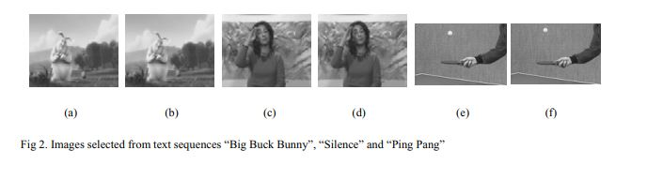
Experimental results 1
In this paper, we used MPEG4 test sequence “Big.Buck.Bunny”, “Silent”, and “Ping Pang” to test our algorithm. Fig 2 shows images selected from these image sequences. Fig 2 (a) and 2(b) shows the 2013th and 2014th frames of the “Big.Buck.Bunny” sequence; 2 (c) and 2 (d) shows the 5th and 6th frames of the “Silence” sequence; 2 (e) and 2 (f) shows the 16th and 17th frames of the “Ping Pang” sequence. Fig 3 shows the segmentation results of the image sequences listed above, where fig 3(a) is the map of the optical flow field of “Big.Buck.Bunny”, fig 3(b) is the Canny edge mask, and fig 3(c) is the result of background edge removal; fig 3(d) is the map of its optical flow field of “Silence”, fig 3(e) is the Canny edge mask, and fig 3(f) is the result of background edge removal; fig 3(g) is the map of its optical flow field of “Ping Pang”, fig 3(h) is the Canny edge mask, and fig 3(i) is the result of background edge removal.

Slide 12
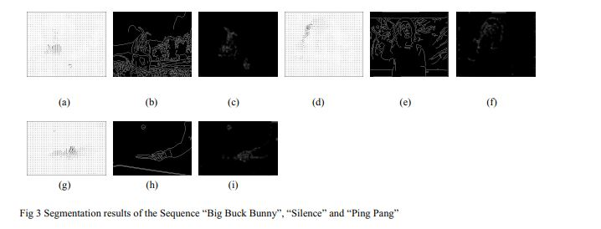
Experimental results 2
From the experimental results, we can find that our algorithm can remove the background edge effectively, and most of the moving edges are remained. Our program is written by Microsoft Visual C++ 6.0, our CPU is IntelCore2 DUO T7100 with 1 GB internal memory. The DK of “Big.Buck.Bunny” is set as 5; the DK of “Silence” is set as 7; The DK of “Ping Pang” is set as 30. Because our method needn’t process pixels of an image one by one, and needn’t any search or release steps, the calculation work is reduced largely.

Slide 13
Conclusion
In this paper, the authors introduce a novel motion segmentation method designed to address the issue of occlusion. Their approach involves the initial use of a Canny Operator on an image, followed by a motion segmentation method based on pattern recognition to eliminate background edges in the Canny segmentation result. Importantly, this method stands out for its efficiency as it eliminates the need for extensive search or release processes, reducing computational workload significantly.

Slide 14
References
[1] R. Fablet, P. Bouthemy. “Motion recognition using non parametric image motion models estimated from temporal and multiscale cooccurrence statistics.” IEEE Trans. on Pattern Analysis and Machine Intelligence, 25(12):1619-1624, December 2003.
[2] C. Rasmussen and G. D. Hager, “Probabilistic data association methods for tracking complex visual objects,” IEEE Transactions on Pattern Analysis and Machine Intelligence, vol. 23, no. 6, pp. 560–576, 2001.
[3] D. Cremers and S. Soatto, “Motion competition: A variational approach to piecewise parametric motion segmentation,” International Journal of Computer Vision, vol. 62, no. 3, pp. 249–265, May 2005.
[4] H. Shen, L. Zhang, B. Huang, and P. Li, “A map approach for joint motion estimation, segmentation, and super resolution,” IEEE Transactions on Image Processing, vol. 16, no. 2, pp. 479–490, 2007.
[5] John Canny. “A computational approach to edge detection.” Pattern Analysis and Machine Intelligence, IEEE Transactions on, PAMI-8(6):679–698, Nov. 1986. [6] A. M. Tekalp, “Digital Video Processing,” Prentice Hall, New York, 1995.

